Slide 1
Cyber Security Best Practices
Oct 17, 2018
Presented by: Daryl Craig
Director, Information Technology
dcraig@Olympic.ca

Slide 2
Cyber Security
Current Cyber Security environment
Who are the Major players
Cyber Security – Recommendations for not for profit organizations
Questions & answers

Slide 3
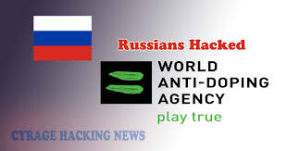
Current Cyber Security environment
Cyber crime/hacking is increasing year over Year
Cyber crime costs are expected to hit $6 trillion annually by 2021
Beyond dollar costs, the hit to an organization’s brand and reputation is unmeasurable
NSFs are a High Risk and High Value cyber targets
Notes:
WAWADA - 2016
Canadian Centre for Ethics in Sports - 2016
During opening ceremonies systems where hacked and had to be shut down and restarted – Pyeongchang Olympics 2018
Australian Olympic Committee is believed to be cyber hacked during the Pyeongchang Olympics for a few days – 2018
Bell Canada lost 1.9 million customer personal information – 2017
City Of Atlanta lost control of its infrastructure (courts, police, etc.) 2018
Air Canada Mobile app lost 20k customer personal information – 2018

Slide 4
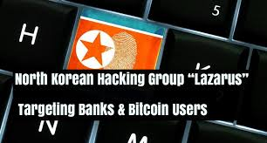
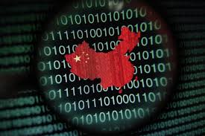
Cyber Security –The Major Players
Notes:
Also known as Fancy Bears, Sofacy Group, Sednit or STRONTIUM
Linked to the Russian government
Believed to be behind:
Democratic National Committee email server hack
WADA, IOC Hack
Meddling with the US, German and French elections
Modus Operandi:
Anything to get the job done
Successfully deployed an UEFI rootkit
~~~~~~~~~~~~~~~~
Also known as Hidden Cobra
Strong relations with APT38 and APT37
Linked to DPRK government
Believed to be behind:
Sony Hack
Wannacry Attack
Crypto currency exchange market in South Korea attack
Recipe Unlimited Ransomware attack
Modus Operandi:
Very prolific in writing malware

Slide 5
Cyber Security - Recommendations
Remove Local Admin Rights (Free)
Standard Login can not install software or make system changes, IT or a special account must be used to make such changes/installs
Common spyware/malware requires Local Admin Rights to be successful
Remove PowerShell – PCs Only (Free)
Used only by Advanced Users, not required in every day use
Most common spyware/malware requires PowerShell to be successful
Ensure Firewalls are enabled on both PCs and MACS (Free)
Most PCs are hacked within an hour if their firewall is not turned on and the PC is connected to the internet
Corporate Next Generation Firewalls (NGF) with Instruction Detection (can be costly)
Only protects equipment while at the office
Can enable Web Filtering which blocks known malicious websites
These 4 Items can reduce Hacking by 90%!

Slide 6
Cyber Security - Recommendations
Enable Two Factor authentication for all access (close to free, MS and Google have Charity Pricing)
Requires a separate code in addition to ones password
Passwords are not secure and often guessed or stolen

Slide 7
Cyber Security - Recommendations
Apply security updates monthly (free/time)
Windows
MACs
Mobile Devices
Applications such as Adobe, Office, etc.
50% of hacking could have been prevented if all security updates where applied

Slide 8
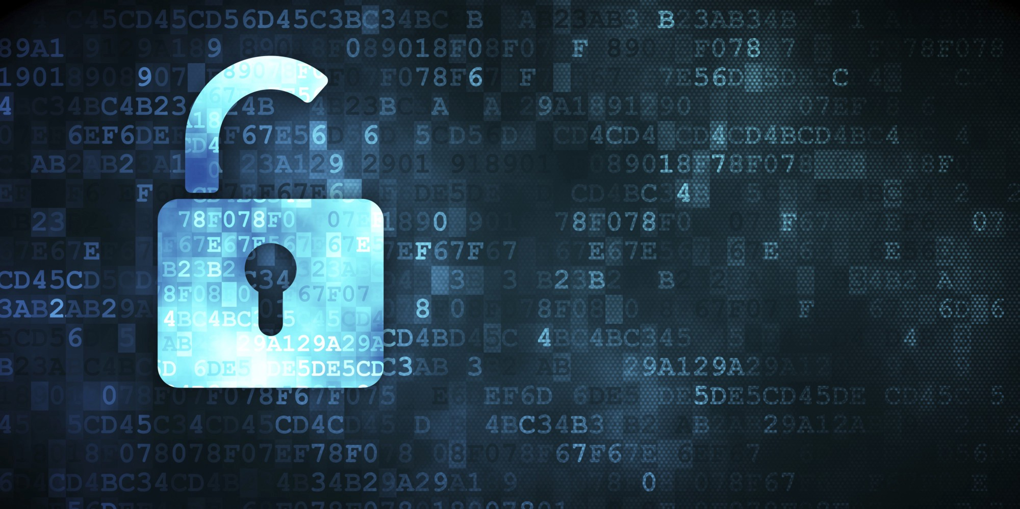
Cyber Security - Recommendations
Encrypt the hard drive of all Desktops/Laptops (Free)
If a laptop/desktop is stolen or lost the data can not easily be recovered
If a laptop/desktop is stolen or lost and its not encrypted you may need to report it to both the Federal and/or Province Privacy Commissioners
Consider encrypting your USB keys as well

Slide 9
Cyber Security - Recommendations
Anti Spam Service (Free to small cost)
Microsoft has a great product called Advanced Threat Protection ($0.73/month per mailbox)
Educate Staff on Cyber Security ideally how to identify and be informed of the consequences of Phishing e-mails (Free/Time)
Enable SPF
A protocol that advertises to the world what IP addresses your organizations e-mail should come from
Don’t forget to include the IP addresses of any mass e-mail blast products you may use i.e. MailChimp, Constant Contact
When other organizations receive e-mails from yours, their e-mail server will check what IP addresses your e-mails should be coming from and if the IP addresses are suspicious the e-mail is blocked because it is considered spam.
91% of cyber crime starts with an email

Slide 10
Cyber Security - Recommendations
Have a Password Policy (Free/Time)
Require complex password
Passwords should change every 90 days
Do not allow the last 5 passwords to be used again
Ensure contractors PCs, Systems adhere to the same or have stricter Cyber Security as your organization requires (Free/Time)

Slide 11
Cyber Security – Other Recommendations
Cyber Security Audit (Can be costly)
Cyber Liability Insurance (Extra cost can be reasonable)
Limit Rights to just enough for each staff member (Requires advanced IT knowledge)
Have an IT acceptable use and Incident Response Policy (Time)

Slide 12
Questions

Slide 13
THANK YOU
MERCI

