Slide 1
SALES TAXES: HST and You
Martin Seaton, CPA, CA

Slide 2
INTRODUCTION
Scottish CA, 1990
Canadian CA, 2007
Saved over $1.5m in HST at Town Shoes Limited
Joined the COC in December, 2014
Notes:
I have had a lot of exposure in HST in “for profit” organizations and now also in the NFP world since joining the COC
There are courses on GST which go for days
CA firms have departments dedicated to it
One of the topics we will discuss today is “Place of Supply”. On that topic alone there are numerous CRA documents including one which is 137 pages – in English alone
In one hour I hope to address the issues which challenge you the most, and also to share just enough information to allow you to know when something ‘just doesn’t seem right’
In preparation for today I reviewed actual NSF invoices and have been given some great input from Dave on topics which will impact NSFs, so thanks for that Dave. If, at the end, you feel that we have missed a topic I look forward to your feedback and who knows maybe we can have a follow-up
That ALL said, although I am well versed and willing to help, nothing can replace a tax specialist when you need one. I also encourage you to contact the CRA directly. I have done so on many occasions over the years and they can be incredibly helpful
Because, as you will shortly see, you may think that one rule applies, when in fact there’s a special clause
Okay so without further ado let’s talk HST

Slide 3
INTRODUCTION TO THE GST
Focus of today is on ITCs on expenses and not on income
GST is a “value-added” tax
Terminology – GST versus HST
Revenue Limit - $30,000 per “rolling” year (4 consecutive quarters)
Notes:
ITC - define
GST is a value-added tax, meaning that the Government collects tax on the final selling price.
GST is the Federal component of HST in certain Provinces. To be discussed later
Why should you care about the $30,000 limit – anyone you deal with who you pay more than that $ to MUST register for GST

Slide 4
IMPORTANT POINTS
Timeliness
Your suppliers’ view on HST
Self-assessment and Charities
Anyone who is registered for GST is registered for HST
“Participating Provinces”
Notes:
You can go back 4 years and adjust for known errors. So can the CRA
Provincial rules vary, for example in BC you can go back 6 years
What you need to know about your suppliers is that, generally, they don’t care about the HST. They get to claim back 100%
because they can claim 100% of HST, self-assessment is far less important to them from the CRA’s perspective. From a charity perspective the CRA is more stringent because they recoup money
We are going to look at examples where self-assessment might be required
GST and registered for HST: What does this mean for you? If you are in a Province with HST and your supplier charges you incorrectly, you can ask them to correct and to charge you HST. As difficult as this may be for you to imagine – asking someone to charge you more tax - we will look at one example later where you WILL want to do this
“Participating Provinces is a commonly-used CRA term to describe Provinces using HST. Non-Participating would be Provinces without HST

Slide 5
WHAT ITC CAN I CLAIM?
Province of “residence” | Tax Rate | PSB % Reclaim
GST (Canada-wide) | 5% | 50%
British Columbia | 7% PST | 57%
Ontario | 8% HST | 82%
New Brunswick / Newfoundland | 8% HST | 50%
Nova Scotia | 10% HST | 50%
PEI | 9% HST | 35%
Quebec | 9.975% PST | 50%
Notes:
Something to note here is that you can be registered in more than one Province. For example the COC is registered in both Ontario & Quebec. While that allows us to recover a portion of the 8% HST in Ontario AND a portion of the QST in Quebec, Place of Supply rules exist to clearly state which taxes may be recovered and to eliminate fraud
If you are registered in more than one Province you have to be very careful where you are invoiced so as not to overstate or understate your tax liability
if you think this might apply to you I suggest you contact the CRA for confirmation

Slide 6
WHAT ITC CAN I CLAIM?
Ontario-Based NSF
Quebec-Based Supplier
Properly Taxed
 |  | Invoice |  | Reclaim
Web Services |  | 1,000.00
GST | 5% | 50.00 | 50% | (25.00)
HST | 8% | 80.00 | 82% | (65.60)
Total Payable |  | 1,130.00 |  | (90.60)
Net Expense |  |  |  | 1,039.40
Notes:
The application of this would look something like this for an Ontario-Based NSF
You don’t have to remember these figures, however I will be showing them again later to display the impact of not being taxed correctly

Slide 7
PLACE OF SUPPLY RULES
Notes:
This is the crux of my presentation today, and possibly one of the more important, and occasionally more complex areas you will encounter
From the many invoices I have seen, it is also the main area where you are paying both too much, and occasionally too little tax
I ask you to remember that these rules are AS confusing for your suppliers. It just won’t impact them anywhere near as much

Slide 8
PLACE OF SUPPLY
Tangible Personal Property (TPP)
Tangible personal property supplied by way of sale
Tangible personal property supplied otherwise than by way of sale
Railway rolling stock supplied otherwise than by way of sale
Real Property (land, real estate & similar)
Intangible personal property (IPP)
General rules
IPP that relates to passenger transportation services
IPP that relates to tangible personal property
IPP that relates to real property
Services
Notes:
There are NUMEROUS areas which all have different “place of supply” rules.
These are the main 4 along with some of their sub-sections.
We are going to focus today on just two – next slide

Slide 9
PLACE OF SUPPLY
Tangible Personal Property (TPP)
Tangible personal property supplied by way of sale
Tangible personal property supplied otherwise than by way of sale
Railway rolling stock supplied otherwise than by way of sale
Real Property (land, real estate & similar)
Intangible personal property (IPP)
General rules
IPP that relates to passenger transportation services
IPP that relates to tangible personal property
IPP that relates to real property
Services
Notes:
We are going to focus on the two most common events which you will experience, goods & services
Services are probably the area where the vast majority of errors will occur and largely because your suppliers don’t tax you correctly

Slide 10
PLACE OF SUPPLY – TPP (GOODS)
General rules - sales of goods
“A supply by way of sale of goods is deemed to be made in a province if the supplier delivers the property or makes it available in the province to the recipient of the supply.
The application of this place of supply rule is generally based on the province in which legal delivery of the goods to the recipient occurs. However, for purposes of the rule, property is also deemed to be delivered in a particular province, and not in any other province, if the supplier either:
ships the property to a destination in the particular province that is specified in the contract for carriage of the property or transfers possession of the property to a common carrier or consignee that the supplier has retained on behalf of the recipient to ship the property to such a destination; or
sends the property by mail or courier to an address in the particular province.”
Notes:
There’s a lot of words here, but essentially goods are taxed where they are finally delivered
I think this is best illustrated through some examples

Slide 11
PLACE OF SUPPLY – TPP (GOODS)
Example 1
An NSF buys supplies for a new athlete recruitment program and ships them directly to their PSOs across the country.
HST applies to the supplies that are shipped to the PSOs that are situated in the participating provinces. GST applies to the supplies that are shipped to the PSOs that are situated in the non-participating provinces (note that you likely also have to self-assess PST in those provinces with GST only, e.g. BC)
Notes:
Supplier shipping versus NSF shipping
Similarly if you are in Alberta and take delivery of goods for use in Ontario you would be expected to self-assess for the Ontario HST component on the amount of goods used in Ontario

Slide 12
PLACE OF SUPPLY – TPP (GOODS)
Example 2
Gymnastics Canada has items to be given away at its national championships delivered to the event location in Prince Edward Island (PEI).
Based on the terms of delivery in the agreement for the sale of the goods, legal delivery of the goods to Gymnastics Canada occurs in PEI.
Because legal delivery of the goods to the purchaser occurs in PEI, the supply of the goods is made in PEI and is subject to HST at a rate of 14%.
Notes:
The key here is that the onus is on the supplier to tax properly

Slide 13
PLACE OF SUPPLY – TPP (GOODS)
Example 3
A supplier in Ontario agrees to sell medals to an Alberta-based NSF. Based on the terms of delivery in the agreement for the sale of the medals, legal delivery of the goods to the purchaser occurs in Ontario. However, the supplier agrees to have the goods shipped to the NSF in Alberta.
Although legal delivery of the goods to the purchaser occurs in Ontario, delivery of the goods to the purchaser is considered to occur in Alberta because the supplier ships the goods to an address in Alberta. The supply of the goods is therefore made in Alberta and GST will apply at a rate of 5%.
Notes:
Distinction between the supplier shipping and the NSF shipping.
In the latter situation you would have to self-assess a rebate of the 8% HST included in Ontario
Also, if instead of having the medals shipped to them in Alberta they had them shipped to PEI, PEI tax of 14% would apply

Slide 14
PLACE OF SUPPLY – TPP (GOODS)
Example 4
A supplier in Nova Scotia makes a supply by way of sale of a good to an Ontario company. Based on the terms of delivery for the sale of the good, legal delivery of the good to the purchaser occurs in Nova Scotia.
The supplier sends the good by courier to an address outside Canada. Although the supply of the good is made in Nova Scotia, the supply of the good is zero-rated as an export because the supplier sends the good by courier to an address outside Canada.
Notes:
This is one example where you would definitely want to consult someone or potentially get a ruling from the CRA. The likelihood is that if you are interested in this area, that you are sending something of significant value overseas, where the taxes could be significant.
One example given was of a yacht or a boat being permanently shipped overseas
Some considerations here would be, are you bringing the item back to Canada, what would its value be then versus now, and would duty apply as well as HST when doing so

Slide 15
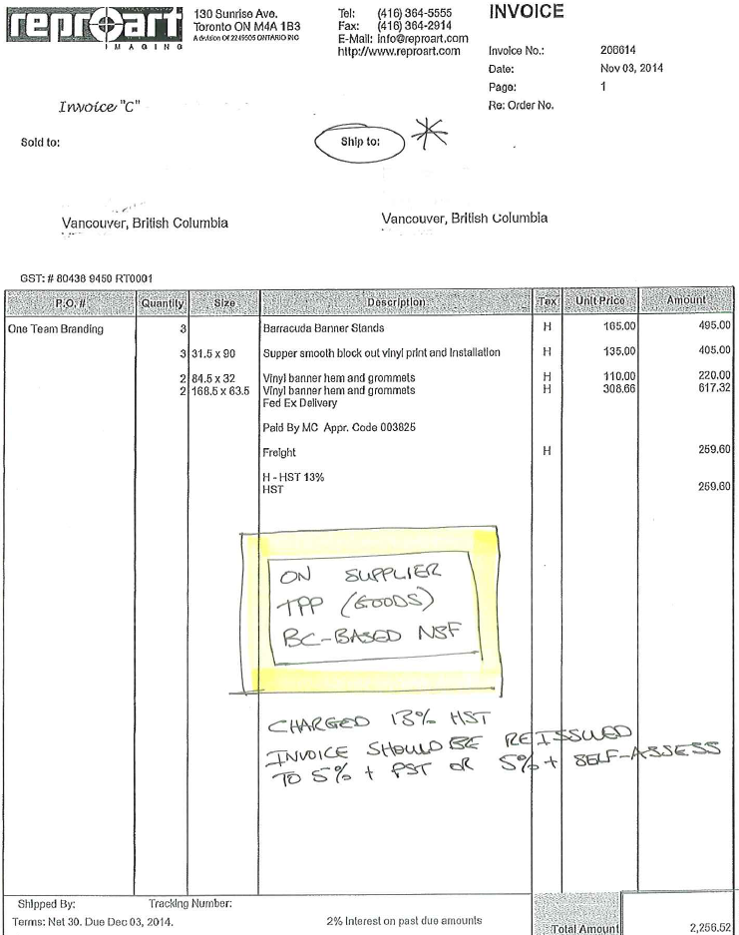
PLACE OF SUPPLY – TPP (GOODS)
Notes:
Here a BC-based NSF was charged 13% HST by an Ontario based supplier.
The supplier shipped the goods to BC,
they should have charged GST only and possibly BC PST if registered for such. (If not the NSF would have self-assessed for the BC PST)
They instead charged ON HST
You may be asking what to do next

Slide 16
PLACE OF SUPPLY - SERVICES
The CRA defines two main “services”:
Services
Personal Services – “a service that is all or substantially all performed in the presence of the individual to whom it is rendered”, e.g. massage therapy.
Generally such personal services will be taxed in the province where they take place.

Slide 17
PLACE OF SUPPLY - SERVICES
Address in Canada obtained
No Address in Canada obtained
Same Highest Tax Rate

Slide 18
PLACE OF SUPPLY - SERVICES
Address in Canada obtained
“A supply of a service is made in a province if, in the ordinary course of business of the supplier, the supplier obtains an address in the province that is
(A) if the supplier obtains only one address that is a home or a business address in Canada of the recipient, the home or business address in Canada obtained by the supplier,
(B) if the supplier obtains more than one address described in paragraph (A), the address described in that paragraph that is most closely connected with the supply, or
(C) in any other case, the address in Canada of the recipient that is most closely connected with the supply.”

Slide 19
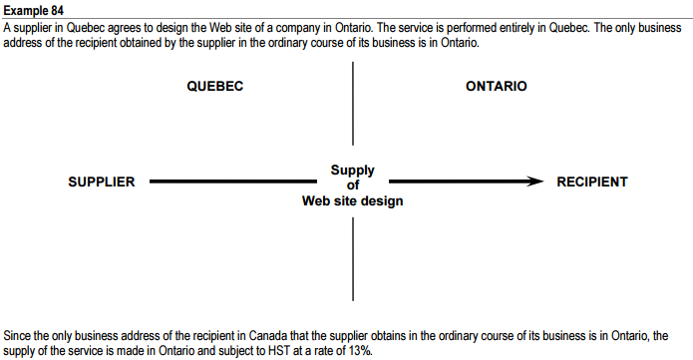
PLACE OF SUPPLY - SERVICES
Address in Canada obtained
Notes:
Real-life. This is the NUMBER 1 area of concern from what I have seen
I have seen this many times
A Quebec-based company does web design work for an ON based NSF
Service is performed completely in QC
Only business address obtained is in ON, and because of that ON HST should be charged at 13%
Lets look at some real examples

Slide 20
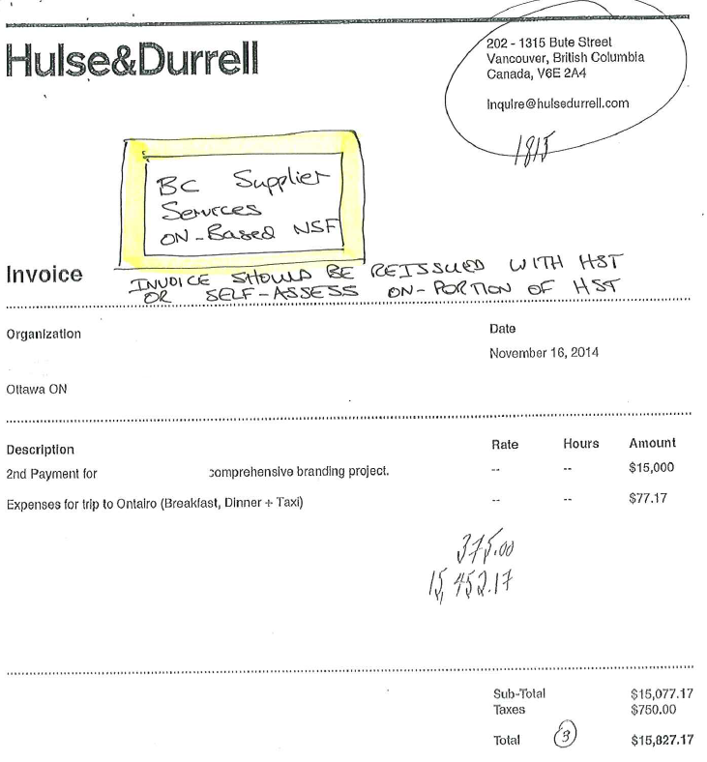
PLACE OF SUPPLY - SERVICES
Notes:
BC based supplier charged GST only to an Ontario based NSF
They should have charged HST. And as we know, if you’re registered for GST, you’re also registered for HST
In this situation the NSF would be expected to self-assess the 8% provincial component of the HST

Slide 21
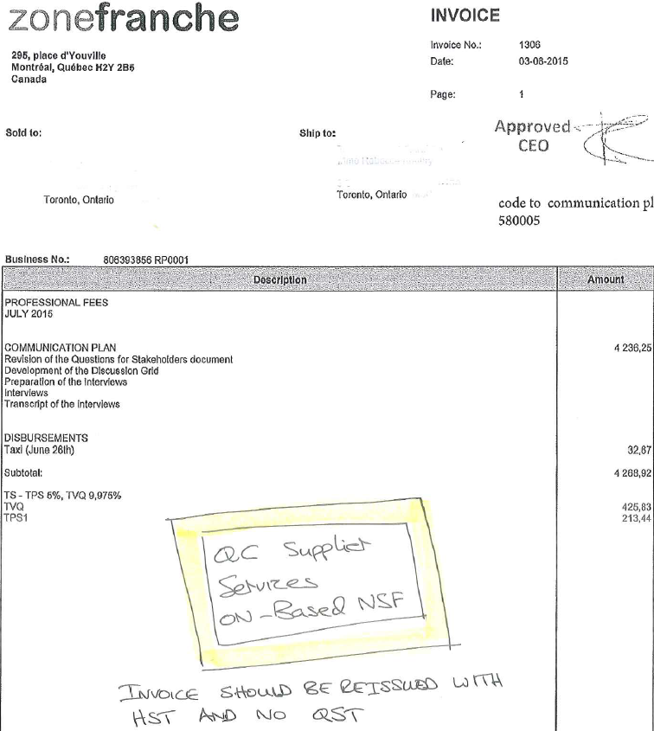
PLACE OF SUPPLY - SERVICES
Notes:
This one has been VERY common in the invoices I have seen and if you are not adjusting you are paying more than you should
Ontario based NSF was charge GST plus QST. They are unable to reclaim QST and so would likely have only claimed the 50% of the GST component
If they do nothing else they are still exposed. The CRA would audit this and assess that you need to self-assess the provincial component of the HST and good luck getting your supplier to adjust 2 years on
The correct route to go here is to call the supplier and ask that they amend the invoice to be HST only. There is a provision in the QST laws that state that this is what they are supposed to do, so don’t allow them to tell you they can’t.

Slide 22
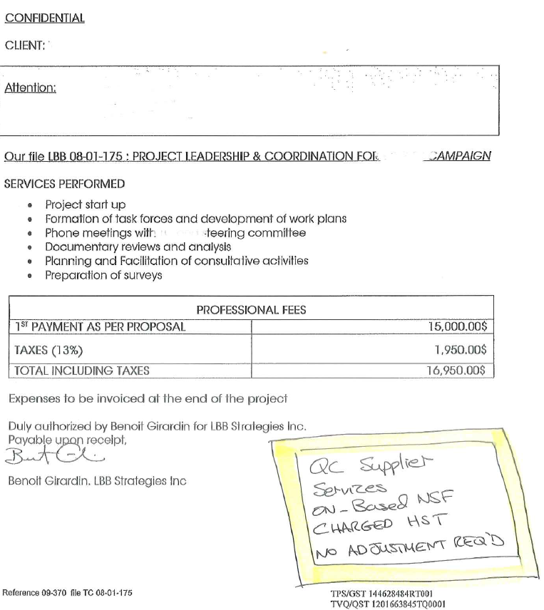
PLACE OF SUPPLY - SERVICES
Notes:
To leave you with some hope. This was an invoice from a Quebec-based supplier for the provision of a service to an Ontario-based NSF where they correctly charged HST

Slide 23
PLACE OF SUPPLY - SERVICES
Quebec
http://www.revenuquebec.ca/en/entreprises/taxes/tpstvhtvq/default.aspx
Notes:
Only because it is the number one area of concern I have seen I wanted to include an excerpt from the Revenu Quebec website.
This is meant as a point of reference for you when discussing with Quebec-based suppliers, many of whom it would appear are not properly applying taxes

Slide 24
PLACE OF SUPPLY - SERVICES
Address in Canada obtained
Notes:
This is the number one area where I have seen errors in invoices you have received. It is a repeat-offender

Slide 25
WHAT ITC CAN I CLAIM?
Ontario-Based NSF
Quebec-Based Supplier
Properly Taxed
 |  | Invoice |  | Reclaim
Web Services |  | 1,000.00
GST | 5% | 50.00 | 50% | (25.00)
HST | 8% | 80.00 | 82% | (65.60)
Total Payable |  | 1,130.00 |  | (90.60)
Net Expense |  |  |  | 1,039.40
Notes:
What is the actual impact of this?

Slide 26
WHAT ITC CAN I CLAIM?
Ontario-Based NSF
Quebec-Based Supplier
Properly Taxed
 |  | Invoice |  | Reclaim
Web Services |  | 1,000.00
GST | 5% | 50.00 | 50% | (25.00)
HST | 8% | 80.00 | 82% | (65.60)
Total Payable |  | 1,130.00 |  | (90.60)
Net Expense |  |  |  | 1,039.40
Ontario-Based NSF
Quebec-Based Supplier
Improperly Taxes
 |  | Invoice |  | Reclaim
Web Services |  | 1,000.00
GST | 5% | 50.00 | 50% | (25.00)
QST | 9.975% | 99.75 | 0% | -
Total Payable |  | 1,149.75 |  | (25.00)
Net Expense |  |  |  | 1,124.75
Increase in Expense |  |  |  | 85.35
 |  |  |  | 8.2%
Notes:
What is the actual impact of this?

Slide 27
PLACE OF SUPPLY - SERVICES
No Address in Canada obtained

Slide 28
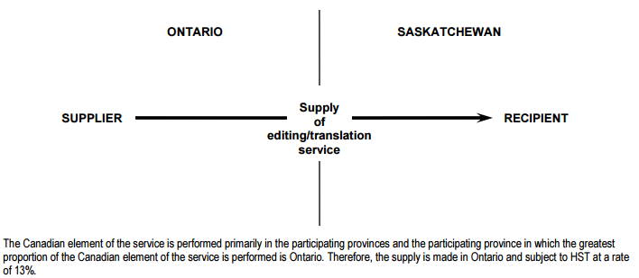
PLACE OF SUPPLY - SERVICES
No Address in Canada obtained
Notes:
ON based company
Provides document editing and translation over the internet
Does not obtain the address for its client in Saskatchewan
The service is performed in ON and ON HST would be applied at 13%

Slide 29
PLACE OF SUPPLY - SERVICES
Same Highest Tax Rate
Notes:
This rule I included only for completeness and I leave you to read it.
I do not see this applying to NSFs ever

Slide 30
PLACE OF SUPPLY - SERVICES
Same Highest Tax Rate
If a supply of a service cannot be determined under Rule 2(C) to be made in a single participating province because the highest tax rates for two or more participating provinces are the same, the supply is made in the specified province among those provinces where the business address of the supplier that is most closely connected with the supply is located or, if such an address is not located in one of the specified provinces, in the specified province that is closest in proximity, determined in any reasonable manner, to the business address of the supplier that is most closely connected with the supply.
Notes:
In the slide deck for completeness, feel free to read it at your leisure as it will almost never arise

Slide 31
BRIEFLY….SERVICES PERFORMED ON TANGIBLE PERSONAL PROPERTY (GOODS)
Notes:
quite distinct from the service rules we have just discussed

Slide 32
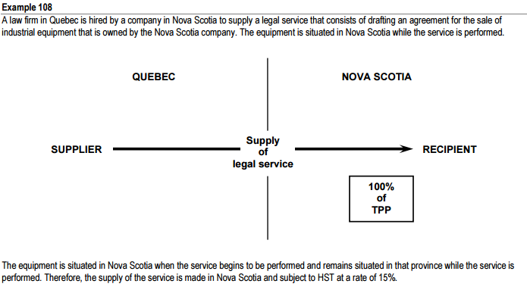
PLACE OF SUPPLY – SERVICES ON TPP
Notes:
QC based law firm does work on TPP being sold in Nova Scotia
Because the TPP is situated in NS, NS HST applies at a rate of 15%

Slide 33
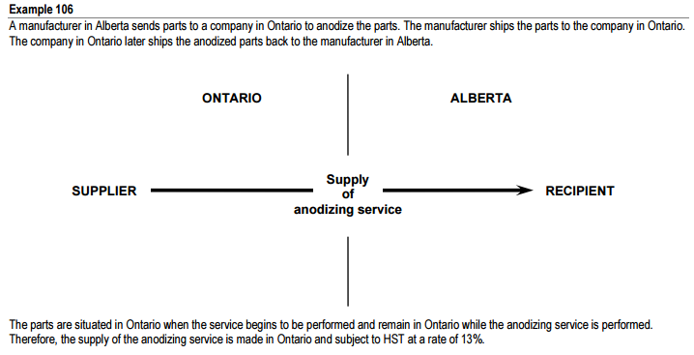
PLACE OF SUPPLY – SERVICES ON TPP
Notes:
You might have something sent out of province, possibly for engraving or finishing of some kind
In this example, parts are shipped from AB to ON to be anodized
Because the service is performed on the TPP in Ontario, ON HST applies at a rate of 13%

Slide 35
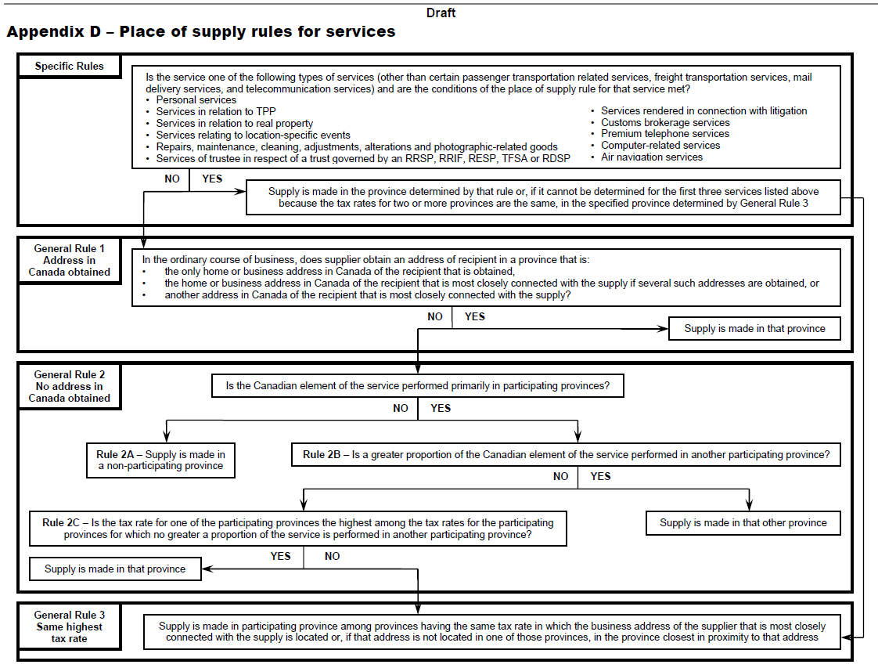
PLACE OF SUPPLY - SERVICES

Slide 36
USEFUL LINKS
Rules for determining Place of Supply of Services
http://www.cra-arc.gc.ca/tx/bsnss/tpcs/gst-tps/gnrl/hst-tvh/srvcs/gnrl-rls-eng.html
GST/HST Information for Charities (RC4082(E) Rev. 13)
http://www.cra-arc.gc.ca/E/pub/gp/rc4082/rc4082-e.html
General Information, Quebec
http://www.revenuquebec.ca/documents/en/publications/in/in-203-v(2013-06).pdf
Quebec Basic Rules, including statement where must charge HST
http://www.revenuquebec.ca/en/entreprises/taxes/tpstvhtvq/reglesdebase/default.aspx
http://www.revenuquebec.ca/en/entreprises/taxes/tpstvhtvq/default.aspx
RC4034 GST/HST Public Service Bodies' Rebate
http://www.cra-arc.gc.ca/E/pub/gp/rc4034/README.html
Very Detailed- Draft GST/HST Technical Information Bulletin B-103, Harmonized Sales Tax – Place of supply rules
http://www.cra-arc.gc.ca/E/pub/gm/b-103/b-103-e.pdf

Slide 37
WHO TO CONTACT
CRA (for all Provinces except British Columbia & Quebec)
In writing Excise and GST/HST Rulings and Interpretations Service
http://www.cra-arc.gc.ca/E/pub/gm/1-4/README.html
General GST/HST enquiries, 800-959-5525
Escalated to: GST/HST Rulings – Experts in GST/HST Legislation, 800-959-8287
British Columbia, 1-877-388-4440
Quebec
In Quebec, Revenu Québec administers the GST/HST. If the physical location of your organization is in Quebec, contact Revenu Québec, at 1-800-567-4692

